Slide 1


Welcome to Hodgepodge

Slide 2
Housekeeping
Toilets
Fire exits
Photography - James Drury
Food - Yahala Mataam
Teas and Coffees (more at 2pm!)

Slide 3
Agenda
11 am - 12:15 pm | Cultivating Fertile Ground: Avoiding harmful practices when designing something new - with Anu Priya
12:15 pm - 12:45 pm | Lunch
12:45 pm - 2:00 pm | Making change with hope in challenging times - with Becca Bunce
2:00 pm - 2:15 pm | Break
2:15 pm - 3:00 pm | Open Session
3.00 pm - 3.30 pm | Ending conversation & check out

Slide 4
Hodgepodge Commitments
Curiosity:
We can all learn something from everyone in the room.
Chatham House Rules:
We can use the information (and learning) that we gain from being here, but cannot reveal the identities or affiliations of the people we learn from.
Recognising your humanity and making space for others:
Think about what you might need to stay present and engaged.
This might mean moving around, or taking a quiet moment, making sure you are drinking enough water, etc. Ask for support from York Together staff and members if you need it.

Slide 5
Hodgepodge Commitments
Sharing experiences:
You may want to share your insight and experiences but there is no expectation to do so. We invite you to only share to the point that you feel comfortable.
Lived experience:
You are invited to speak from your own lived experience. We respect that someone’s lived experience is their own.
Step forward/step back:
Take time to reflect on the space you occupy in the room. i.e. If you are someone who tends to speak a lot, you may wish to ‘step back’ into a listening role and vice versa.

Slide 6
Hodgepodge Commitments
Expectation of discomfort:
We recognise discomfort enables transformation. We invite you to take a break if things feel too uncomfortable.
Disagreement:
There might be points of disagreement or misunderstanding. We recognise that this can be part of coming together. If you feel uncomfortable or if any disagreement feels unresolvable in the moment, please come and talk to any member of York Together, and we will support you.

Slide 7
Hodgepodge Commitments
Use of phones/devices:
Some people in the room might need to use their phones/devices (whether for taking notes or for their own access needs).
If you are using them for work emails or for any other reason that will disconnect you from Hodgepodge, we kindly invite you to step out of the room.
There is no space for hate speech.

Slide 8
Hodgepodge Commitments
Aftercare…
If things come up for you during the day, you can check in with York Together by emailing hello@yorktogether.org.
We really love Healing Justice Ldn’s aftercare menu, which you might also find helpful.

Slide 9
Check in
1. From high energy to shattered, how are you arriving/leaving today?
2. From feeling despairing to hopeful (specifically around making York a fair, just, and more sustainable place), how are you feeling?
3. From feeling really connected to disconnected, how connected do you feel to other groups working to tackle social injustice in York?

Slide 10
Cultivating Fertile Ground
Anu Priya | Hodgepodge, York Together

Slide 11
Aims
Expose the harmful structures that quietly shape the way we work
Recognise the patterns you and your group repeat without thinking
Leave with practical tools to try and build alternatives

Slide 12





Trauma is a natural response
Freeze
Flight
Fight
Flop
Fawn

Slide 13
What am I for ?

Slide 14
What is a core value?

Slide 15
What are you accountable for?
Who are you accountable to?

Slide 16
Traps
Goalposts keep changing
Bureaucracy protects ‘order’
Expectation that you respond in measured ways despite bad behaviour
Individualism, isolation
Not recognising agency and choice
Binary thinking - this/that, good/bad, for me/ against me
Gatekeeping from a place of fear, worry, concern

Slide 17
Designing ‘different’
What roles do we play/ need?
What skills do we need to develop?
What capacities do we need to create?
What support do we need?
What access do we have to possible change?
How do we live our values?
What (inadvertent) harms are we causing?

Slide 18
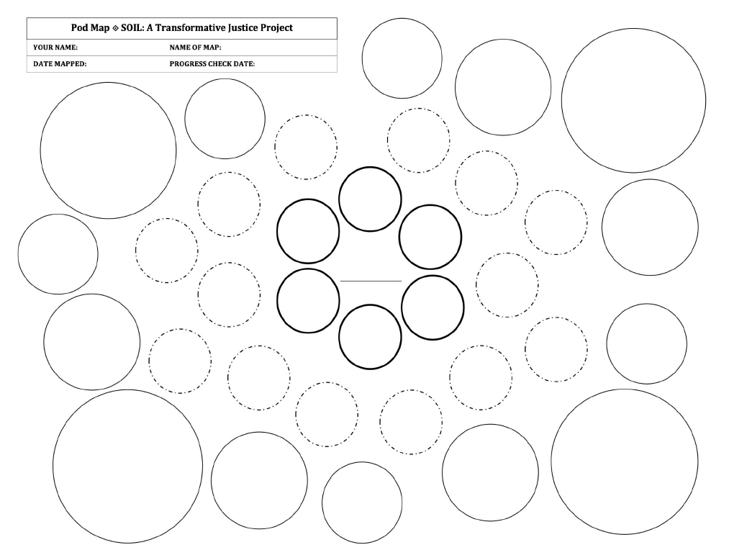
Pod-Mapping

Slide 19
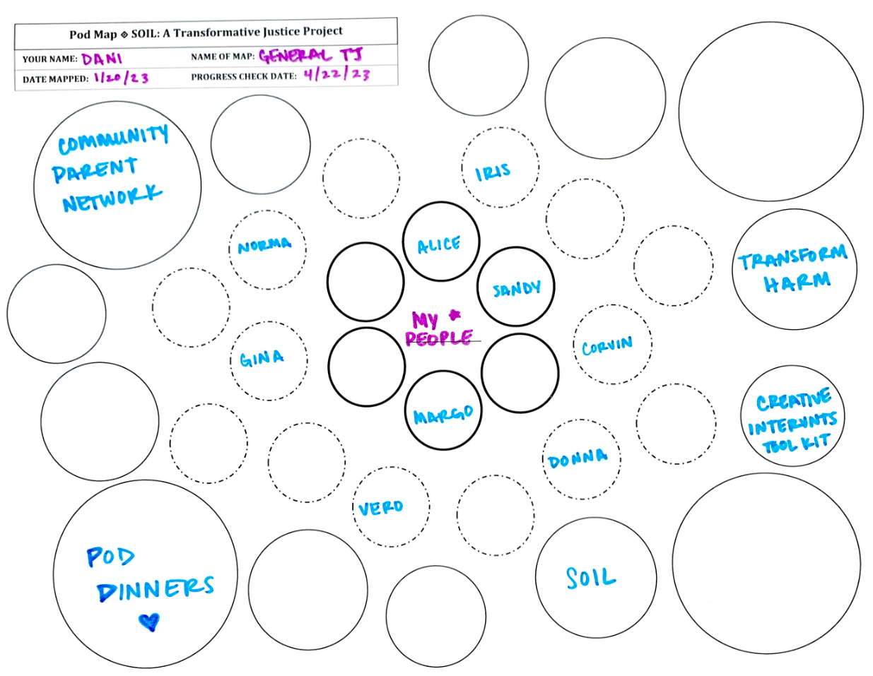
General Pod-Map

Slide 20
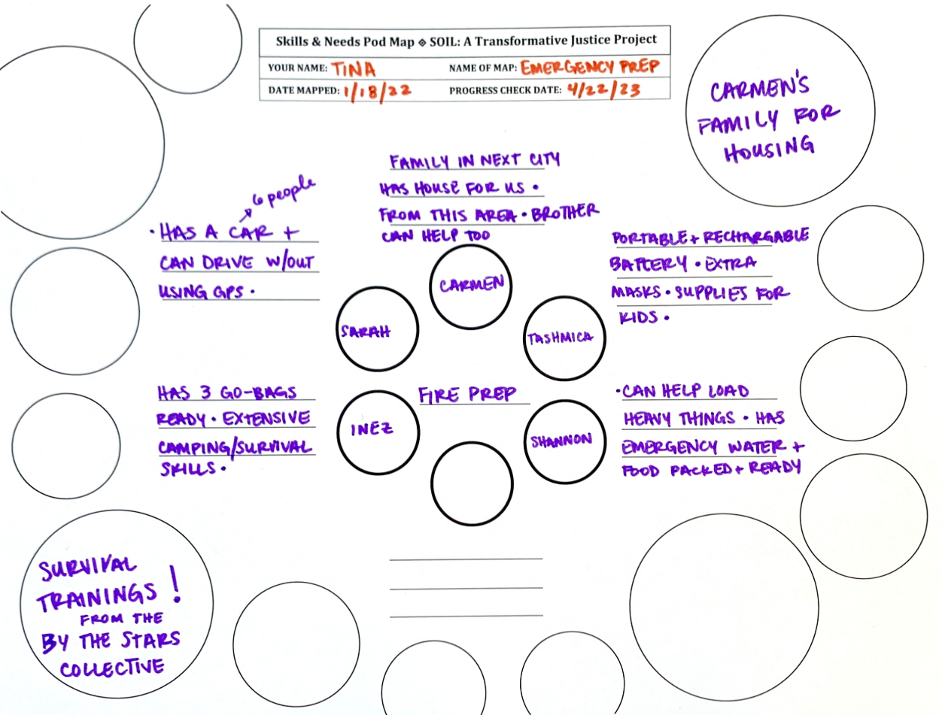
Emergency/ Crisis Pod-Map

Slide 21
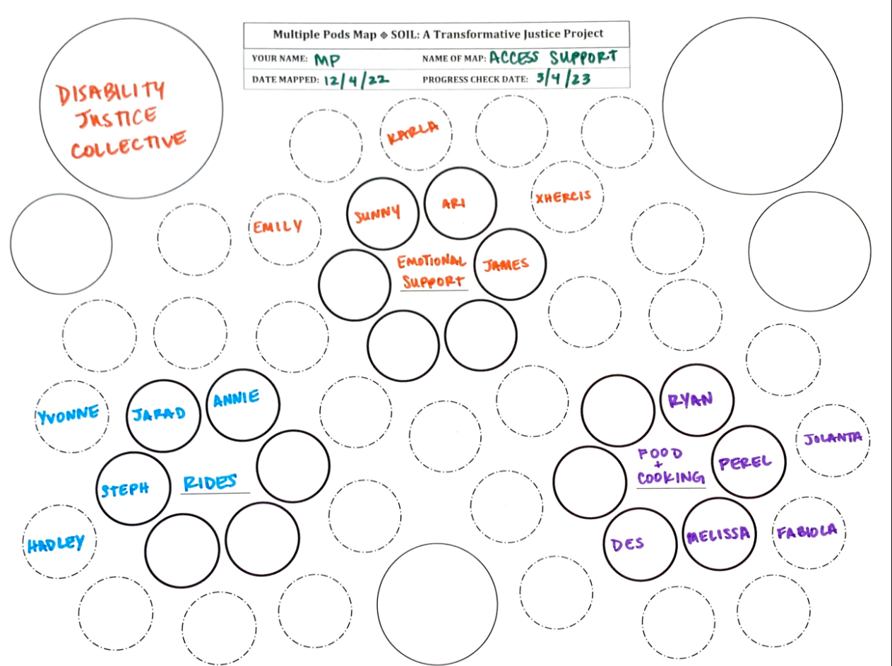
Multiple Pods

Slide 22
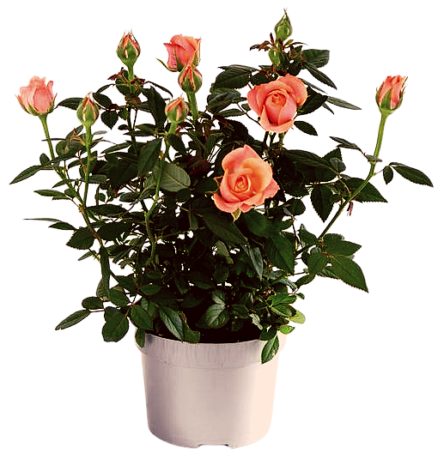
Reflections
Rose
Something that really bloomed for you
Thorn
Bud
Something that is a bit scratchy for you, something you’ve found difficult
Something that feels new for you, that you want to tend to or explore more

Slide 23
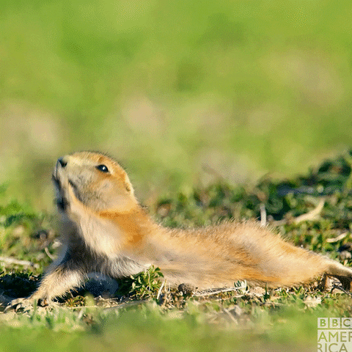


Slide 24

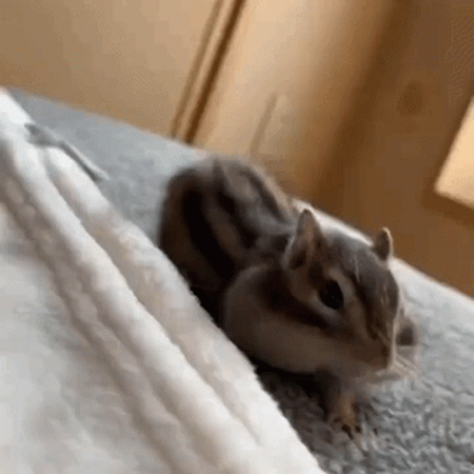

Slide 25

Lunch Time!
Back at 12:45
Next up:
Making change with hope in difficult times

Slide 26
Pod-Mapping Resource
https://www.soiltjp.org/

Slide 27
Lunch
30 minutes
All vegan and provided Yahala Mataam

Slide 28

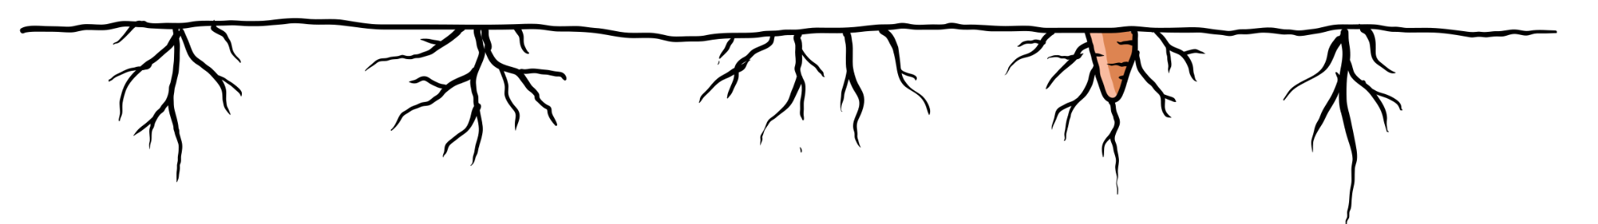
What nourishes
(or fuels)
you?
Examples:
Walking the dog/ time outside
Choir/crafting/reading/comedy
Team sports/swimming/run
A cup of tea or good meal
New music/favourite song
Time with friends/family
Creating change!

Slide 29
What is important to us:
A chance to witness what nourishes us.
Person A: Opens exercise by asking - “What nourishes or fuels you?”
Person B: Answer question. [Person B: listens, can take notes] (2.5 mins)
Person A: Repeat back what you’ve heard the other person say - without analysis! Just what you’ve heard. (1.5 mins)
Person A: Ask -“Is there anything I have missed or is important to you?”
Person B: Respond with any clarifications/nuances (1 min)
Person A: Repeat back what you’ve heard (30 seconds)

Slide 30
Hope can come from places of inspiration
When we want to create change it helps when we get specific about what action, behaviour or impact inspires us.
I’d like to look to three places for inspiration:
By people, groups or organisations working on the same issue as you
By people, groups or organisations working on other issues/across issue areas
By people/groups/organisations or spaces in York

Slide 31
Hope can come from places of inspiration
Two things on each post-it note:
the name of individual/ group/organisation/space; and
a specific action/reason they bring you hope/inspire you

Slide 32
Grounding ourselves in hope
Reflections from post-it notes:
How can we build our change-making approaches/tactics up from inspiration?
How do we understand how our work connects to each other?

Slide 33
Break
15 minutes

Slide 34
Open Session
45 minutes
- Quiet Room
- Collaboration
- Chat with Becca, Anu and York Together

Slide 35
Ending conversation and check out
What is the next helpful step?
From high energy to shattered, how are you arriving/leaving today?
From feeling despairing to hopeful (specifically around making York a fair, just, and more sustainable place), how are you feeling?
From feeling really connected to disconnected, how connected do you feel to other groups working to tackle social injustice in York?

Slide 36
Thank you!

